Slide 1
HMH Science Dimensions
Unit 8: Evidence for Evolution
Lesson 1: Lines of Evidence for Evolution
Notes:
The learning experiences in this unit prepare students for the mastery of
Performance Expectations
LS1-2 Develop and use a model to illustrate the hierarchical organization of interacting systems that provide specific functions within multicellular organisms.
LS1-3 Plan and conduct an investigation to provide evidence that feedback mechanisms maintain homeostasis.
ETS1-2 Design a solution to a complex real-world problem by breaking it down into smaller, more manageable problems that can be solved through engineering.
ETS1-3 Evaluate a solution to a complex real-world problem based on prioritized criteria and trade-offs that account for a range of constraints, including cost, safety, reliability, and aesthetics, as well as possible social, cultural, and environmental impacts.

Slide 2

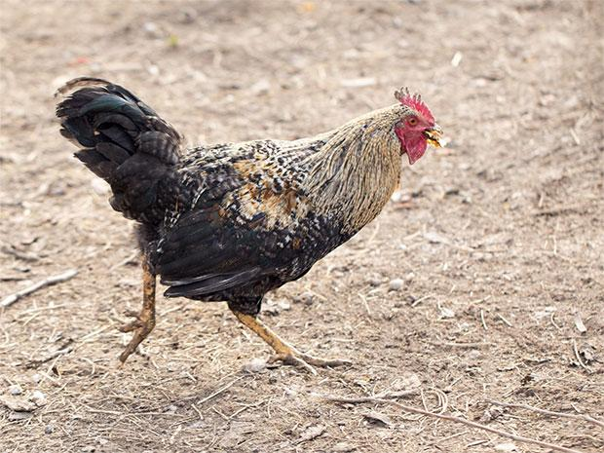
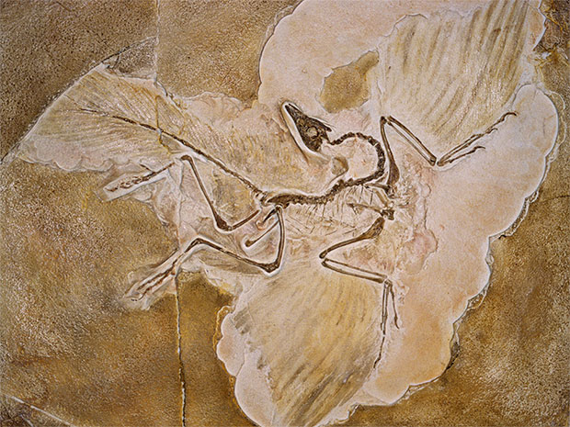
Can You Explain It?
Unit 8 Lesson 1
Do you think chickens and other birds could be descendants of dinosaurs?
What evidence would you need to support such a claim?
Modern Chicken
Dinosaur Fossil
Notes:
Lesson Objective
Construct explanations about the evidence that supports common ancestry and evolution of living organisms.

Slide 3
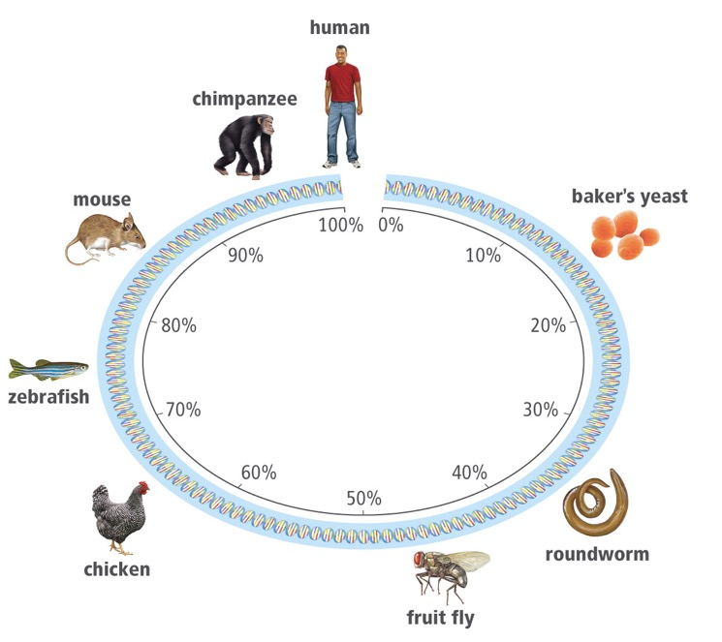
Molecular and Genetic Evidence
Unit 8 Lesson 1
Evolution is the process of biological change by which descendants come to differ from their ancestors.
All living things on Earth share DNA as their genetic code. We all have the same four basic nucleotides that make up our genome.
The more related two species are, the more similar their DNA will be.

Slide 4

Molecular and Genetic Evidence Hands-On Lab: Piecing Together Evidence
Unit 8 Lesson 1
In this activity, you will receive pieces of "evidence" about a picture in order to make observations, inferences, and predictions about it.

Slide 5
Molecular and Genetic Evidence
Unit 8 Lesson 1
ANALYZE
How do patterns in DNA support the claim that living things share a common ancestor?

Slide 6
Molecular and Genetic Evidence
Unit 8 Lesson 1
Sequences of DNA nucleotides known as pseudogenes also provide evidence of evolution. Pseudogenes are genes that no longer function but are still carried along with functional DNA.
Similarities among cell types across organisms can also be revealed by comparing their proteins. A unique set of proteins is found in specific types of cells. Cells from different species that have the same proteins most likely come from a common ancestor.

Slide 7
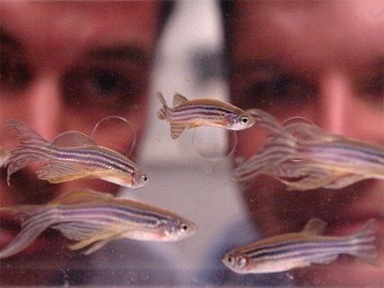
Molecular and Genetic Evidence Engineering
Unit 8 Lesson 1
Zebrafish have 70 percent of the same genes as humans and a rapid life cycles. These organisms are ideal models for the study of shared genes.
Zebrafish have been used as a model organism for research on many human diseases.
Make a list of criteria and constraints a researcher would need to consider when choosing a model organism for a human disease study.
Include factors related to the organism’s development and life cycle, the genetic basis of the disease being studied, and any ethical considerations.

Slide 8
Molecular and Genetic Evidence Hands-On Activity: Predicting Evolutionary Relationships
Unit 8 Lesson 1
Analyze similarities in a protein common to bacteria and eukaryotes. Then use the results of your analysis to draw conclusions about similarities among species.

Slide 9
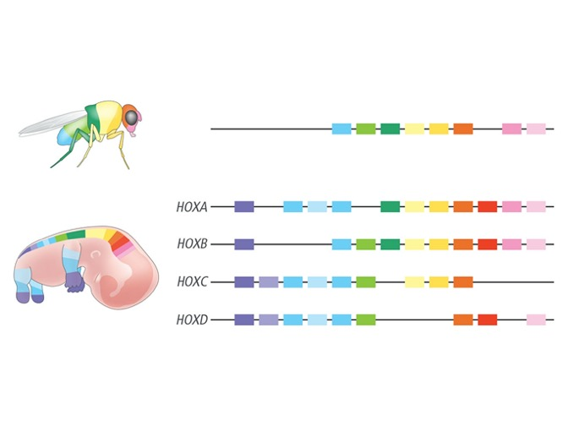
Molecular and Genetic Evidence
Unit 8 Lesson 1
As an animal develops, its genes guide the formation of organs and the arrangement of body parts.
Certain types of homeobox genes, Hox genes, help to guide the process that results in the development of an organism's characteristic body plan.
COLLABORATE
1. What patterns do you see in the similarities and differences between Hox genes in humans and in fruit flies?
2. How do your observations support the claim that humans and fruit flies share a common ancestor?

Slide 10
Unit 8 Lesson 1
Molecular and Genetic Evidence
EXPLAIN
Archaeopteryx is seen by some experts as a link between reptiles and birds.
What types of cellular or molecular evidence might a scientist study in order to determine the evolutionary relationship between the chicken and modern reptiles?

Slide 11
Unit 8 Lesson 1
Developmental and Anatomical Evidence
Organisms that resemble each other in their development are more closely related than others with different patterns of development.
Scientists use developmental and anatomical features to make inferences about evolutionary relationships among species.

Slide 12
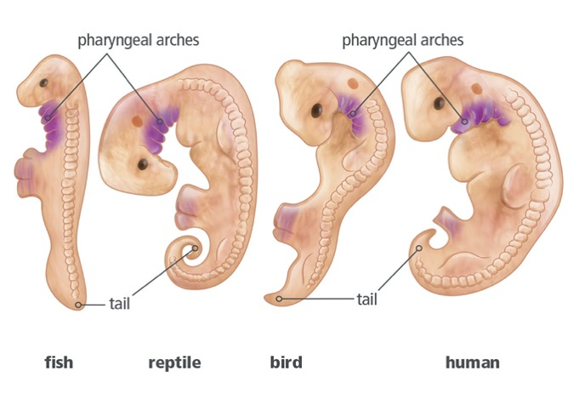
Unit 8 Lesson 1
Developmental and Anatomical Evidence
Developmental Similarities
Invertebrates have an initial larval stage in which many organisms look quite similar, suggesting an evolutionary connectedness.
All vertebrates have three basic body features as embryos—a tail, limb buds, and pharyngeal arches.
All vertebrates go through a stage of development with common features.
What similarities do the vertebrate embryos in the illustration share?
How does this pattern of similarities help support common ancestry?

Slide 13
Unit 8 Lesson 1
Developmental and Anatomical Evidence
Anatomical Evidence
Homologous structures are features found in different organisms that share structural similarities but may have very different functions.
Their appearance across different species offers strong evidence for common descent.

Slide 14
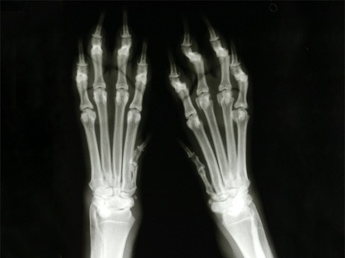
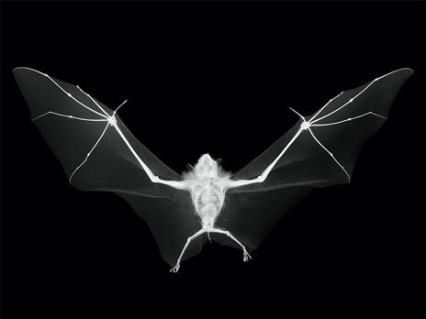
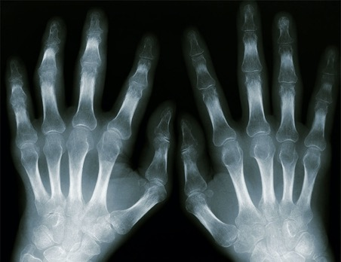
Unit 8 Lesson 1
Developmental and Anatomical Evidence
GATHER EVIDENCE
What patterns do you notice in the structures below in terms of similarities?
How do the similarities support common ancestry?
Dog Feet
Bat Wings
Human Hands

Slide 15
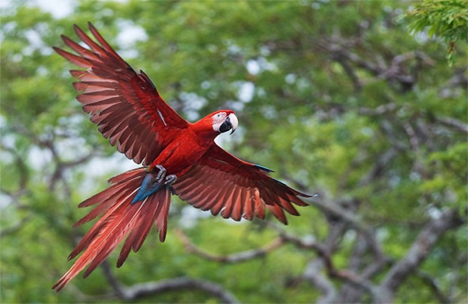
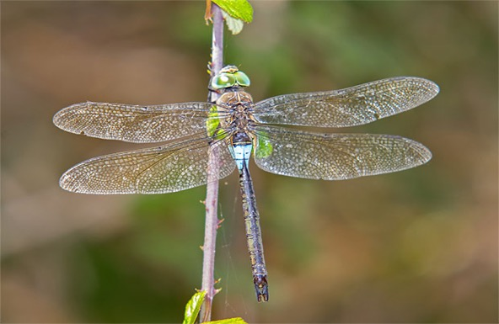
Unit 8 Lesson 1
Developmental and Anatomical Evidence
Analogous structures are structures that perform a similar function but are not similar in origin.
Both bird and insect wings have similar shapes and structures because they are both used for flight.
However, wings develop differently in birds and insects, and they are made of different tissues.
Bird wings and dragonfly wings are examples of analogous structures.

Slide 16
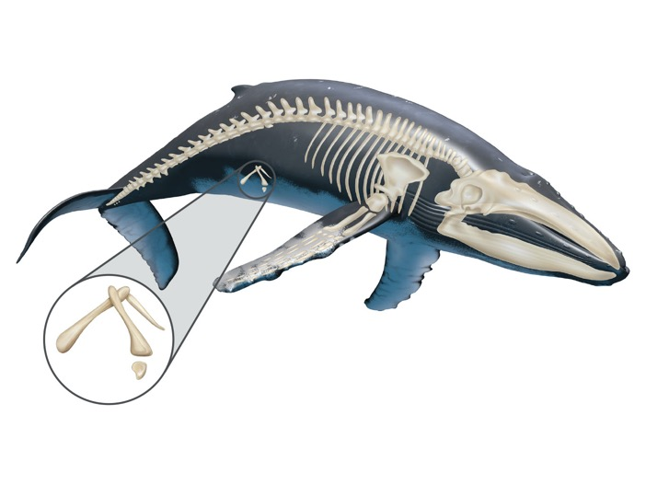
Unit 8 Lesson 1
Developmental and Anatomical Evidence
Vestigial structures provide clues to an organism's evolutionary past.
Consider the traces of pelvic bones present in the humpback whale shown in the Whale Skeleton illustration. The pelvis normally sits near leg bones, such as the femur in humans.
Whale Skeleton | Many whale species have vestigial pelvic and leg bones.
How does the evidence in the diagram of the whale support the idea that whales evolved from land mammals?

Slide 17
Unit 8 Lesson 1
Developmental and Anatomical Evidence
EXPLAIN
What similarities in anatomical structures provide evidence of a link between the chicken and the Archaeopteryx?
What additional evidence would help support the claim that these organisms share a common ancestor?

Slide 18
Unit 8 Lesson 1
Geological and Fossil Evidence
Scientists study clues left behind in ancient rocks and discover traces of organisms that have long been extinct. Fossils are an important piece of evidence used to determine the evolutionary history of a species.
Why are the concepts that Earth undergoes change and is billions of years old important for evolutionary theory?

Slide 19
Unit 8 Lesson 1
Geological and Fossil Evidence
Geologic Evidence
Georges Cuvier, a French zoologist of the late 1700s, did not think that species could change. However, his observations of fossil remains convinced him that species could go extinct.
In the late 1700s, the Scottish geologist James Hutton proposed that the changes he saw in landforms resulted from slow changes over a long period of time, a principle that became known as gradualism.
In the 1830s, British geologist Charles Lyell expanded Hutton's theory of gradualism into the theory of uniformitarianism. This theory states that the geologic processes that shape Earth are uniform, or remain the same, through time.

Slide 20
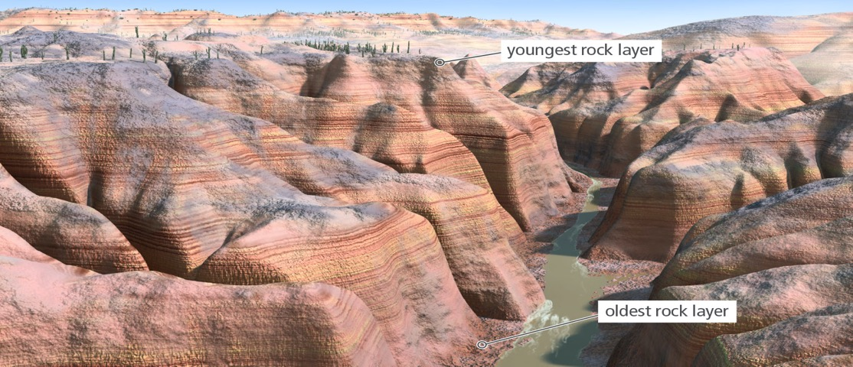
Geological and Fossil Evidence Cause and Effect
Unit 8 Lesson 1
Uniformitarianism | This model shows evidence of slow, gradual change over time.
How do the geological features shown in the illustration support the claim that slow, gradual changes add up over long periods of time to cause great change?

Slide 21
Unit 8 Lesson 1
Geological and Fossil Evidence
Fossil Evidence
A fossil is the preserved remains of an organism, or the trace evidence of an organism's existence in the past. Most fossils form in sedimentary rock.
Layers of rock form gradually over long periods of time, with more recent layers typically on top of older layers. Fossils that differ from each other slightly and are embedded in different layers of rock provide evidence for gradual change in species over time.
By studying the fossils found in individual rock layers, scientists can determine the approximate age of each fossil.

Slide 22
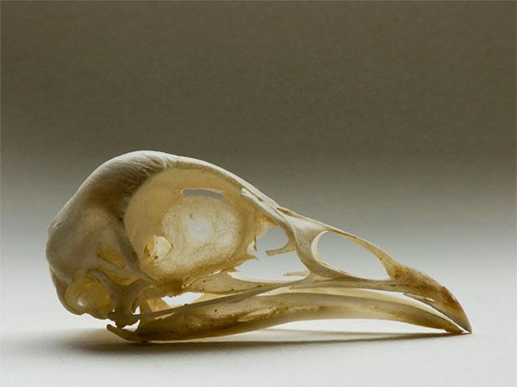
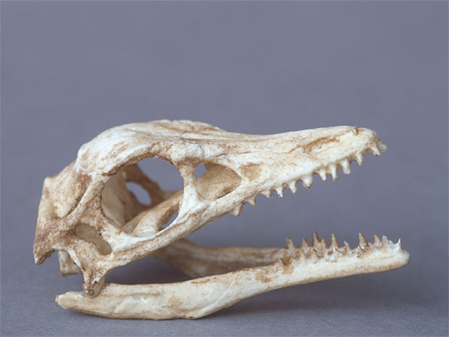
Unit 8 Lesson 1
Geological and Fossil Evidence
Archaeopteryx skull replica
Chicken Skull
EXPLAIN
Look at the Archaeopteryx and chicken skulls. What are the similarities, and what are the differences?
How does the fossil evidence support the idea that birds share a common ancestor with dinosaurs?

Slide 23
Unit 8 Lesson 1
Continue Your Exploration
Choose one of the paths below to continue your exploration:
Radiometric Dating
Career: Evolutionary Biologist
Whale Evolution

Slide 24
Can You Explain It?
Unit 8 Lesson 1
What evolutionary evidence supports the conclusion that chickens and other modern birds are descendants of dinosaurs?
Refer to the notes in your Evidence Notebook and write a short explanatory text that cites specific evidence from this lesson about lines of evidence for evolution to support your claim, and explain your reasoning.

Slide 25
Image Credits
Unit 8 Lesson 1
rooster ©schankz/Fotolia; scientists researching zebra fish ©Toronto Star/Vince Talotta/Getty Images; X-ray of human hands ©domin_domin/iStockPhoto.com; X-ray of bat ©Nick Veasey/Getty Images; X-ray of dog's paws ©Irina Alyakina/Fotolia; macaw ©Peter Schoen/Moment/Getty Images; dragonfly ©asfloro/Fotolia; Archaeopteryx skull ©Natural Visions/Heather Angel/Alamy; chicken skull ©danilo ducak/Shutterstock; Archaeopteryx fossil ©Naturfoto Honal/Corbis Documentary/Getty Images

